Slide 1

HACKATOPIA 2K26 · NATIONAL-LEVEL HACKATHON
CB-02
CB-02 — SBOM RISK & TRUST AUDITOR
Team Memebers
Shreesha A S
Shravan S Kotian
Akshatha Poojary
Raksha Kiran
An Intelligent Approach to Software Supply Chain Risk
Prioritization
“Know What You Depend On. Trust What You Scan. Fix What Matters.ˮˮ

Slide 2






02/10
Software Supply Chain Security: Beyond Vulnerability Detection
Problem ID: CB-02
Problem Title: SBOM Risk & Trust Auditor
The Problem:
Modern applications rely on third-party software components that may contain known vulnerabilities. Complex dependencies and incomplete SBOM information make these risks difficult to assess and prioritize.
Current Real-World Situation:
Existing tools identify vulnerabilities, but developers still need to evaluate the evidence, understand dependency risks, and decide what to fix first.
Who Is Affected?
  Developers and software maintainers
  DevSecOps teams and security analysts
  Organizations relying on open-source and third-party software
Why Does It Matter?
  Vulnerabilities can enter applications through third-party dependencies.
  Long vulnerability lists make remediation priorities difficult to determine.
Supporting Statistics
  66% — In ENISA's analysis of 24 supply-chain attacks published in 2021, approximately 66% focused on suppliers' code.
  #1 Emerging Threat — ENISA's 2024 cybersecurity foresight report ranked Supply Chain Compromise of Software Dependencies as the top emerging cybersecurity threat toward 2030.

Slide 3
02 | THE GAP IN EXISTING APPROACHES
03/10
What Is Already Being Done?
Organizations use SBOMs and vulnerability scanners to identify software security risks.
Existing Approaches / Solutions
  SBOM Generators: Syft
  Vulnerability Scanners: Trivy, Grype
  Security Databases: OSV, CISA KEV
  Dependency Monitoring: Dependabot
Current Pain Points & Limitations
  Incomplete SBOM information.
  Complex dependency relationships.
  Difficulty prioritizing vulnerabilities.
Where Do Existing Approaches Fall Short?
Security findings often require separate analysis to understand risk and decide what to fix first
Identified Gap
A unified solution connecting vulnerability risk, SBOM quality, and remediation priorities.

Slide 4
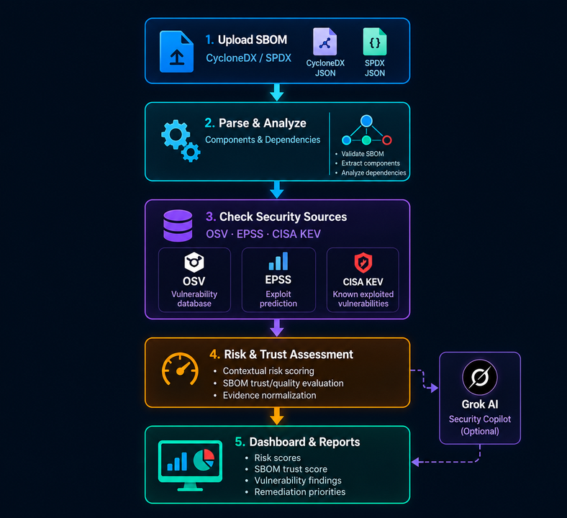
03 | OUR SOLUTION04/10
Proposed Solution:
Solution Overview
A unified SBOM auditing platform that analyzes software components, checks known vulnerabilities, and calculates contextual risk and SBOM trust scores.
solution diagram:
How It Solves the Problem
  Detects known vulnerabilities using security databases.
  Evaluates vulnerability risk using available evidence.
Input → Processing → Output
Input: SBOM File (CycloneDX / SPDX)
Processing: Component Analysis → Vulnerability Matching → Risk & Trust Assessment
Output: Risk Score → SBOM Trust Score → Prioritized Findings

Slide 5
04 | WHAT MAKES OUR APPROACH USEFUL?
05/10
Innovation & Unique Value Proposition
What Is Genuinely New or Improved?
  Combines vulnerability risk scoring with SBOM quality assessment.
  Considers multiple security signals for contextual risk analysis.
What Makes It Different?
  Unifies vulnerability findings and SBOM trust insights.
  Considers dependency context and exploit intelligence.
  Provides prioritized, evidence-based findings.
Unique Value Proposition (USP):
One platform to assess vulnerability risk, evaluate SBOM quality, and prioritize remediation.
Why Should Users Choose This Solution?
  Clearer Risks: Understand vulnerability priorities.
  Better Visibility: Identify SBOM quality gaps.

Slide 6
How the Solution Works
06/10
01
User Upload: Upload an SBOM file.
02
Input Validation: Validate CycloneDX or SPDX format.
03
Parsing: Extract components and dependencies
04
API Integration: Fetch data from OSV, EPSS, and CISA KEV.
08
Action: Prioritize vulnerabilities and plan fixes.
05
Risk Analysis: Calculate vulnerability risk scores.
06
Trust Assessment: Evaluate SBOM quality and completeness.
07
Results Dashboard: Display findings and risk levels.
DECISION POINTS
Invalid SBOM → clear error · unavailable intelligence → unknown/unavailable · missing relationships → lower confidence · unavailable fix → no invented version · no active scan → empty state.

Slide 7
06 | TECHNOLOGY STACK
07/10
TECHNOLOGY STACK
Built with Modern Web Technologies & Security Intelligence
FRONTEND
  React 19, Vite, Tailwind CSS v4
Node.js, Express 5, Multer
CycloneDX JSON and SPDX JSON parsers
Groq, first EPSS,OSV,CISA
Contextual Risk Scoring Engine
Copilot
Backend Memory,local storage,SQL Lite 3
BACKEND
SBOM PROCESSING
INTELLIGENCE
ANALYSIS
OPTIONAL AI
STORAGE / TESTING

Slide 8
FORMULA
Contextual Risk-Scoring Formula
R = 0.40 × Vulnerability Severity (CVSS)
+0.20 × Dependency Context
+0.15 x Exploit Prediction Score (EPSS)
+0.10 × CISA Known Exploited Vulnerabi
+0.10 x Fix Availability
  +0.05 × Evidence Quality
Risk Score=∑Applicable Weights∑(Factor Score×Weight)​×100

Slide 9
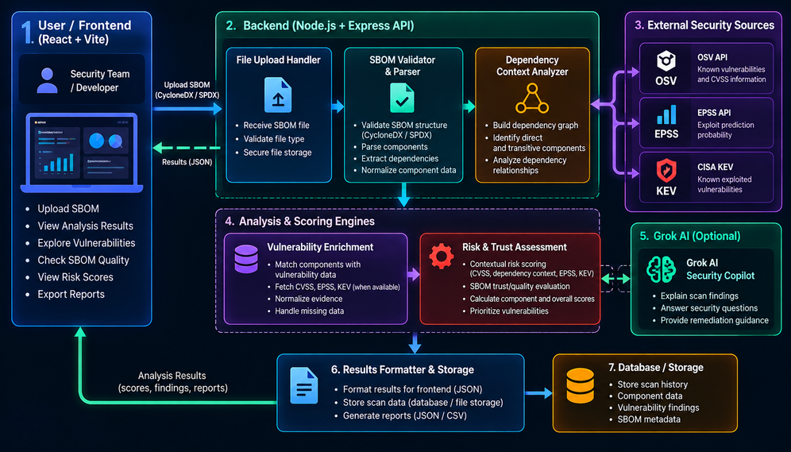
System Architecture:

Slide 10
TECHNICAL FEASIBILITY & IMPLEMENTATION
Implementation Approach:
  React + Vite frontend; Node.js + Express backend
  Parse CycloneDX/SPDX SBOMs and enrich findings using OSV, EPSS, and CISA KEV
  Apply deterministic risk scoring and SBOM quality analysis
24-Hour Development Strategy:
  0–4 hrs: UI setup, architecture, and SBOM upload
  4–10 hrs: Parsing and vulnerability data integration
  10–16 hrs: Risk scoring and trust analysis
  16–21 hrs: Dashboard, findings, and error handling
  21–24 hrs: Testing, integration, and demo preparation
Major Challenges & Mitigation:
  Incomplete SBOM data → Flag unknowns instead of assuming safety
  External API failures → Handle errors and clearly indicate unavailable data
  Limited development time → Prioritize a working core flow over advanced features
Prototype / Demo Status:
  Working prototype: SBOM upload and analysis workflow, risk scoring, trust scoring, and findings dashboard
  Test result: Sample SBOM with 2 components, 5 findings, and a MEDIUM overall risk score
  Future work: Production hardening, broader testing, and scalable deployment

Slide 11
09 | WHAT COMES NEXT?
09/10
FUTURE SCOPE
From SBOM Analysis to Continuous Software Supply Chain Security
Integrations & AI Improvements
Future Enhancements
Expansion & Long-Term Vision
  Support more programming ecosystems and SBOM formats
  Enable team collaboration, role-based access, and scalable cloud deployment
  Evolve into a continuous software supply chain risk platform
.
  Continuous SBOM monitoring and automated rescanning
  Dependency risk trends and remediation tracking
  Exportable security reports and compliance dashboards
  Integrate more vulnerability databases and security tools
  Enhance the AI Copilot with clearer, evidence-linked explanations
  Add CI/CD pipeline integration for early risk detection
Vision: Make software supply chain security proactive, scalable, and easier for every development team.

Slide 12
10 | CONCLUSION
10/10
Finding Vulnerabilities Is Only the Beginning.
PRIORITIZATION
TRANSPARENCY
Makes risk assessments and SBOM quality easier to understand.
EVIDENCE AWARENESS
Highlights missing information and uncertainty instead of assuming the software is safe.
Helps developers identify which vulnerabilities deserve attention first
Our Vision:
To build a more secure software ecosystem where organizations can understand their dependencies, prioritize risks, and make confident security decisions.
“DONʼT JUST SCAN YOUR SOFTWARE. UNDERSTAND ITS RISK. TRUST THE EVIDENCE.ˮˮ
HACKATOPIA 2K26 · CB-02 — SBOM RISK & TRUST AUDITOR

